Slide 1
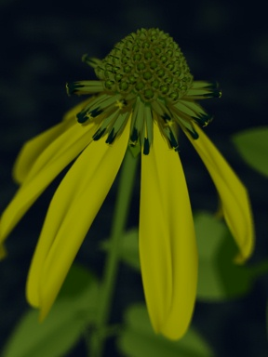
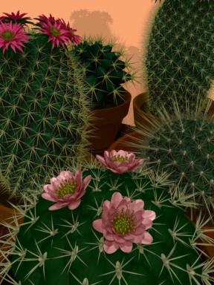
L-systems
Presented by Luv Kohli
COMP258
October 30, 2002
Images copyright © 1992 D. Fowler, P. Prusinkiewicz, and J. Battjes

Slide 2
Overview
What are L-systems?
What are they used for?
L-systems notation
Extensions to basic L-systems
Survey of recent applications

Slide 3
What are L-systems?
Conceived as mathematical theory of plant development by Aristid Lindenmayer
Much of L-systems work done by Przemyslaw Prusinkiewicz
Similar to grammars from theory of computation
Employ the idea of rewriting

Slide 4
Rewriting
Technique for defining complex objects by successive replacement of initial simple object
Rewriting rules or productions
Example: von Koch snowflake curve

Slide 5

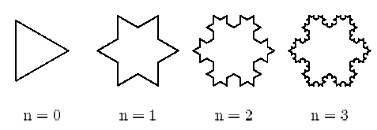
Snowflake curve example
generator
initiator
productions

Slide 6
L-systems vs. Grammars
Grammars apply productions sequentially
L-systems apply productions in parallel
There are languages that can be generated by context-free L-systems that cannot be generated by context-free grammars

Slide 7
DOL-systems
Deterministic, context-free L-systems
Simplest class of L-systems
Intuitive example:
  Consider strings built of letters a and b
  Associate a rewriting rule with each letter (e.g., a → ab, b → a)

Slide 8
DOL-systems
Process starts with a string called the axiom
Productions
b → a
a → a b
b
axiom
a
a b
a b a
a b a a b

Slide 9
Formal notation
An L-system is an ordered triplet
G = <V, w, P>
V = alphabet of the system
w Є V⁺ = nonempty word (the axiom)
P = finite set of productions

Slide 10
Derivation
Let μ = a₁…a_{m} be an arbitrary word over V
The word v = x₁…x_{m} is directly derived from μ iff a_{i} → x_{i} for all i = 1, …, m.

Slide 11
Graphics/modeling
Plants can be thought of as repeated productions from a seed
petal
petal
petal
petal
petal
leaf
leaf
stem
seed

Slide 12
Graphics/modeling
Turtle interpretation of strings (based on LOGO)
Turtle state: (x, y, α)
(x, y) = Cartesian position
α = heading angle
Given a step size d and angle increment δ, several turtle commands can be specified

Slide 13
Turtle commands
Turtle commands represented by symbols:
  F: move forward d units, draws line of length d
  f: move forward d without drawing
  +/-: turn left/right by angle δ
  [: push current state
  ]: pop previous state

Slide 14
Modeling in 3D
Turtle interpretation can be extended to 3D
Orientation in space represented by three vectors:
  H: heading
  L: direction to the left
  U: up direction
Rotations specified by 3x3 matrix
Additional commands for turtles in 3D

Slide 15
Extensions to L-systems
Stochastic L-systems
  Variation in results can be achieved by randomization of turtle interpretation or stochastic application of productions
Context-sensitive L-systems
  Productions may depend on neighboring symbols in input string

Slide 16
Extensions to L-systems
Parametric L-systems
  Discrete nature of L-systems makes it difficult to model continuous phenomena
  Numerical parameters are associated with L-system symbols
  Parameters control the effect of productions

Slide 17
Applications of L-systems
L-systems used extensively for plants and biological systems
  Parallel production similar to idea of cell division
Applications not restricted to biological systems
  Cities, bridges
  Multiresolution representations

Slide 18
“Procedural Modeling of Cities”
Yoav I H Parish, Pascal Müller
Propose algorithm to model a city based on L-systems
Algorithm divided into four main stages:
  Roadmap creation (L-systems)
  Division into lots (subdivision)
  Building generation (L-systems)
  Geometry (parser)

Slide 19
Algorithm
Basic algorithm input is geographic map and population density map
Roadmap creation uses an extended L-system implementation that separates parameters from production rules
Stochastic, parametric L-system used for generation of building geometry

Slide 20
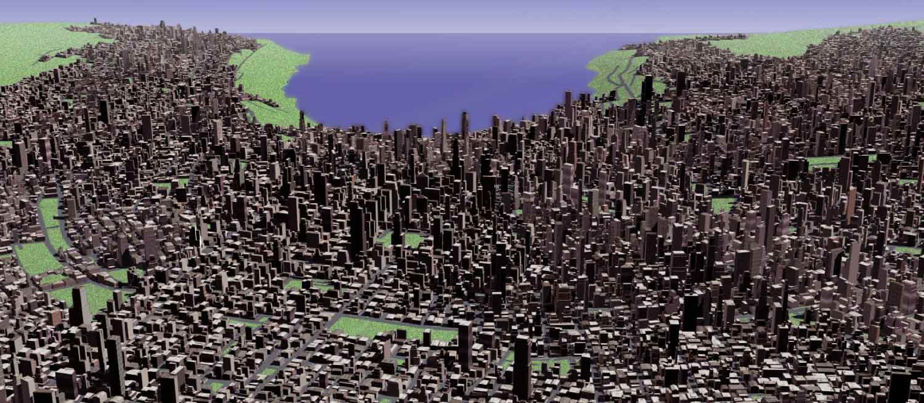
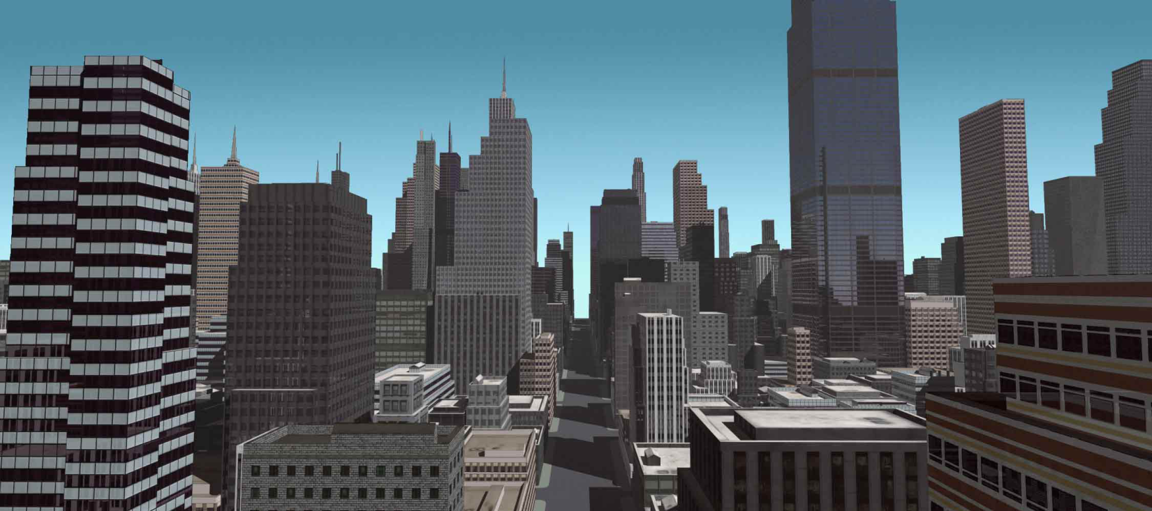

Slide 21
“Modeling and Rendering of Realistic Feathers”
Yanyun Chen, Yingqing Xu, Baining Guo, Heung-Yeung Shum
Two tasks involved in modeling and rendering feathers:
  Modeling individual feathers
  Growing feathers on birds
Individual feathers rendered using a bidirectional texture function controlled by a parametric L-system
Takes into account gaps in vanes of feathers and other realistic ideas

Slide 22


Slide 23
“A Multiresolution Mesh Generation Approach for Procedural Definition of Complex Geometry”
Robert F. Tobler, Stefan Maierhofer, Alexander Wilkie
Propose a general approach to procedural mesh definition and modification:
  Generalized subdivision
  Rule-based mesh growing

Slide 24
Generalized subdivision
Generalized subdivision approach allows different subdivision rules at each level of subdivision
Different subdivision schemes (e.g. Catmull-Clark, Loop, etc.) can be used at each level
Allows arbitrary mesh operators at each step (vertex placement, etc.)

Slide 25
Rule-based mesh growing
Extension of L-systems to work on connected symbols representing faces in a mesh
Allows controlled introduction of complex geometry for fine details

Slide 26
Rule-based mesh growing
Starting symbol = base mesh
Each face assigned a symbol
Define production rules for each symbol
Recursively replace faces by meshes

Slide 27
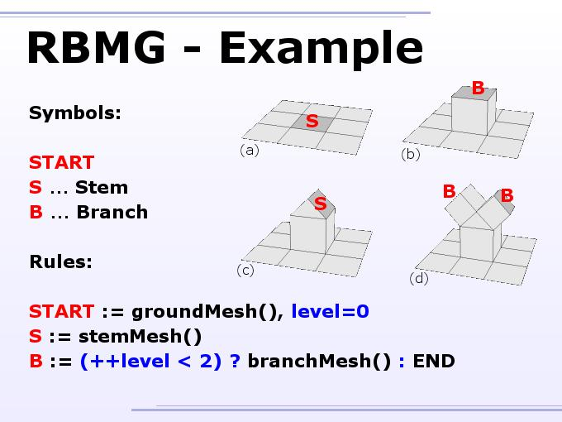

Slide 28
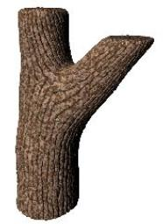
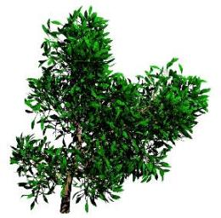


Slide 29
“L-system Description of Subdivision Curves” (submitted 2002)
P. Prusinkiewicz, F.F. Samavati, C. Smith, R. Karkowski
Introduce parametric context-sensitive L-systems with affine geometry interpretation as alternative technique for specifying and generating subdivision curves
Captures subdivision in a concise manner

Slide 30
References
Prusinkiewicz, P. and Lindenmayer, A. The Algorithmic Beauty of Plants. Springer-Verlag, 1990.
Parish, Y. I. H., and Müller, P. 2001. Procedural modeling of cities. In Proceedings of SIGGRAPH 2001.
Shum, H.-Y., Guo, B., Xu, Y., Chen, Y. Modeling and Rendering of Realistic Feathers. ACM Transactions on Graphics, Proceedings of the 29th annual conference on Computer graphics and interactive techniques July 2002.
Wilkie, A., Maierhofer, S., Tobler, R. F. A Multiresolution Mesh Generation Approach for Procedural Definition of Complex Geometry. International Conference on Shape Modelling and Applications 2002. Banff, Alberta, Canada, May 17-22 2002.

